Slide 1
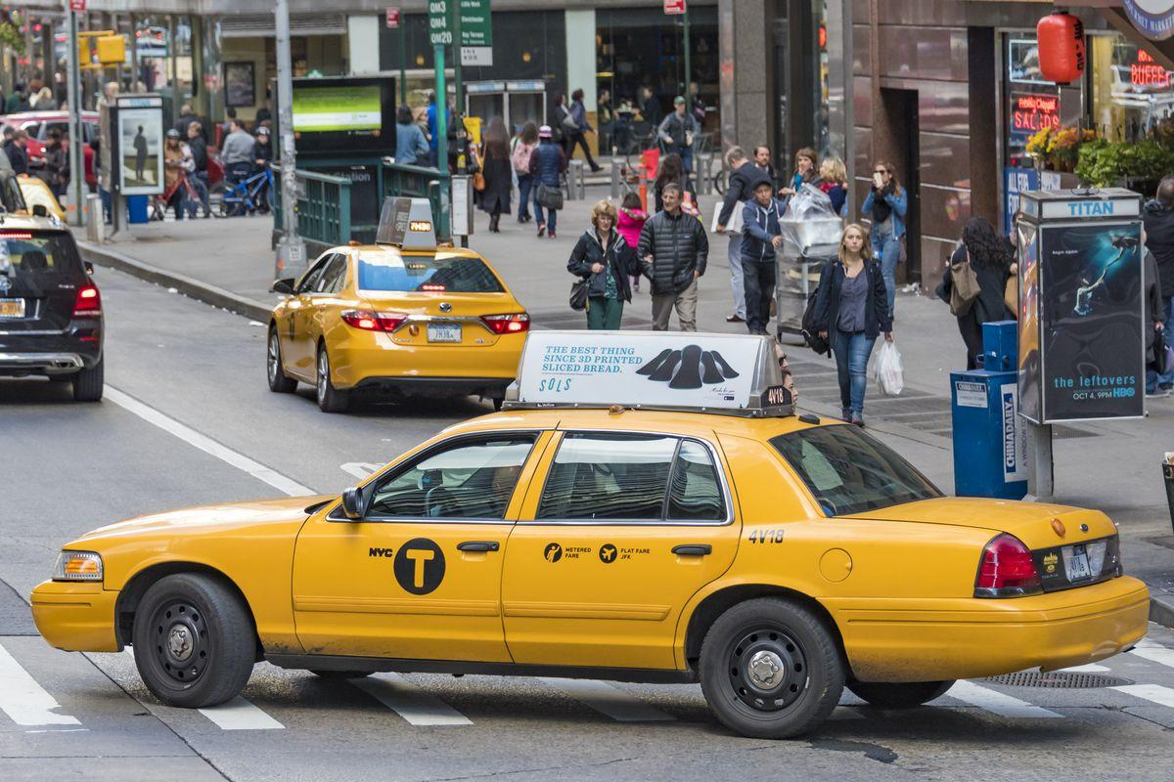
New York City Taxi and Limousine Commission Trip Record Analysis
Capstone 2 - Job Connector Data Science Online Learning

Slide 2
Executive Summary
This report is intended for company’s executive level and its business team of NYC TLC, as the agency who is responsible for licencing and regulating New York’s City taxi cabs, for-hire vehicles, commuter vans, and paratransit vehicles. This report will allow the business team to look over the condition of the trips made by passengers and decide what action should be taken by the company’s executive in order to improve the business performance.
There has been a variation in trip counts for vehicles tracked by Vendor 1 (Creative Mobile Technologies, LLC) and Vendor 2 (VeriFone Inc.). Moreover, There has not yet been an in-depth analysis of passenger preferences
In this report, we provide a deep analysis about the trip condition and passengers’ trip preferences to understand their habit and create comprehensive actionable plans to improve the NYC TLC services.
Statistical Tests and Exploratory Data Analysis are being used to find and answer specific business problem happened.
Conclusion and Recommendation also will be provided as
Notes:
Perkenalan
Tujuan analisa
Masalah utama ( turunnya revenue)
Objective utk naikin revenue

Slide 3
Table of contents
01
02
03
04
05
Overview
About NYC TLC Trip Record Dataset
Problem Statement
And Objective of Analysis
Data Preparation
And Data Cleaning
Data Analysis
EDA and Hypothetical Test
Recommendation
And Conclusion

Slide 4
Overview
01
NYC TLC Trip Dataset

Slide 5
NYC TLC Trip Record Analysis
01 | Overview
There are two datasets that will be used for this analysis:
NYC TLC Trip Dataset
Taxi Zones
NYC TLC Trip Record is a dataset that summarizes the customer journey of taxi passengers in the US, including pickup and drop-off locations, payment details, and the amount of money paid, among other information.
Taxi Zones dataset is used as a reference to look more specifically at the cities, areas, and regions from which passengers depart and arrive.
We have made some adjustments for the Date. We will be focusing on January 2023 recorded data for the analysis.
January 2023
Recorded Date
63766 Total Passengers
Recorded by 2 Vendors
$ 1.3 Mil Revenue Generated
During 1 month period.

Slide 6
Methodology
Define Business Problems
Data Preparation and Cleaning
Data Analysis
Data Visualization
Recommendation
Datasets Used in Analysis
NYC TLC Trip Record
Taxi Zones
Defining Problem Statement
Defining Objective
Start gathering data and cleaning data using Python
Analysing the data to gain insights using python
making data visualization in Tableau
Making recommendation based on analyzed data
- VendorID
- lpep_pickup_datetime
- lpep_dropoff_datetime
- store_and_fwd_flag
- RatecodeID
- PULocationID dan DOLocationID
- passenger_count
- trip_distance
- fare_amount
- extra
- mta_tax
- tip_amount
- tolls_amount
- total_amount
- payment_type
- trip_type
- OBJECTID
- Shape_Leng
- the_geom
- Shape_Area
- zone
- LocationID
- borough

Slide 7
Problem Statement
02

Slide 8
Problem Statement
Problem
Lack of Understanding Regarding Passenger Preferences:
NYC TLC has designated two vendors for tracking taxis: Vendor 1 (Creative Mobile Technologies, LLC) and Vendor 2 (VeriFone Inc.). Currently, we observe that during the recorded period, a significantly higher number of trips occurred for vehicles tracked by Vendor 2 compared to Vendor 1. This significant difference suggests that vehicles tracked by Vendor 1 may have different characteristics compared to those tracked by Vendor 2.
There has not yet been an in-depth analysis of passenger preferences based on time, and types of trips. Therefore, we are not yet able to optimize the trips occurring for each vendor.

Slide 9
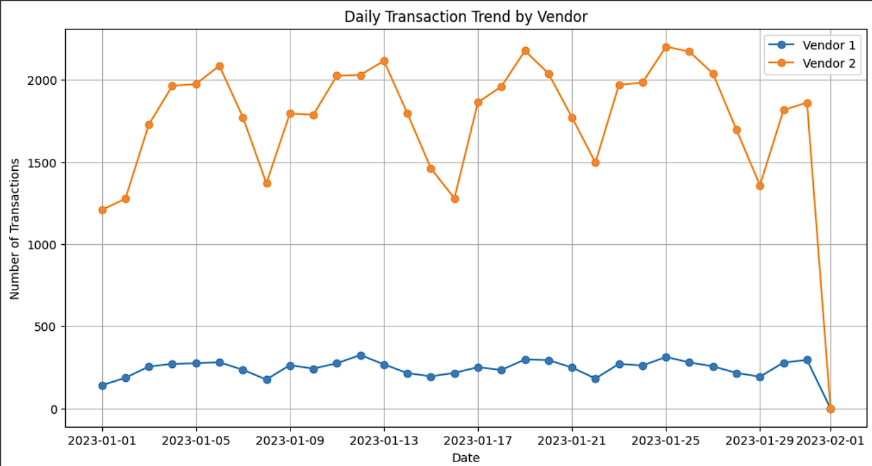
Significant Daily Trip Volume Disparity Between Vehicles tracked by Vendor 1 and Vendor 2 Throughout January 2023
02 | Problem
VeriFone Inc. (Vendor 2) vehicles consistently outperform Creative Mobile Technologies, LLC (Vendor 1) in daily transactions, often exceeding 1,500 transactions per day, compared to Vendor 1's steady volume of around 500 or fewer.
Vendor 2 shows notable fluctuations in transaction volume with clear peaks and troughs, suggesting variability in demand or operations. In contrast, Vendor 1 maintains a stable but lower transaction volume.

Slide 10
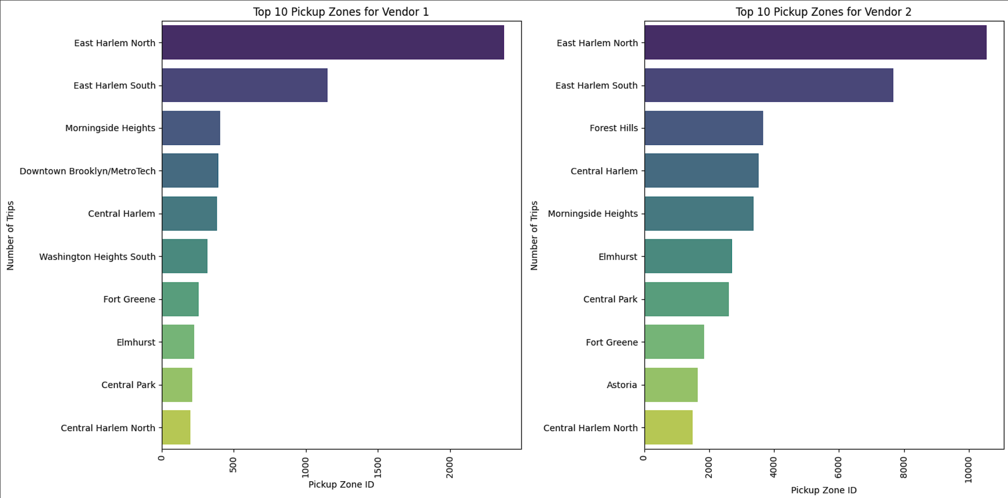
Highly Concentrated in Two Primary Zones: East Harlem North and East Harlem South.
02 | Problem
For both vendors, East Harlem North and East Harlem South are the top pickup zones, indicating a significant focus on these areas.
This concentration in specific zones suggests that taxi operations are heavily reliant on high-demand areas, which could inform strategies for optimizing fleet deployment and enhancing service coverage in less frequented zones.

Slide 11
Objective
Objective
The data analyst team is tasked with conducting an in-depth analysis to:
Identify the differences in travel characteristics between vehicles tracked by Vendor 1 (Creative Mobile Technologies, LLC) and Vendor 2 (VeriFone Inc.).
Identify passenger preferences based on time (hour, day of the week) and types of trips (short distance vs. long distance).
Provide business strategy recommendations that can increase the number of trips and revenue based on the findings from the analysis.

Slide 12
Data Preparation & Cleaning
03

Slide 13
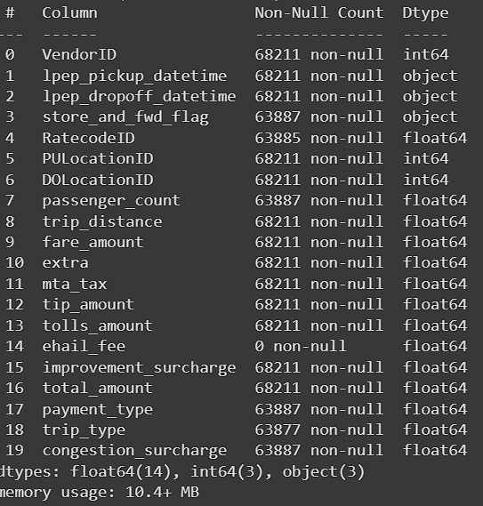
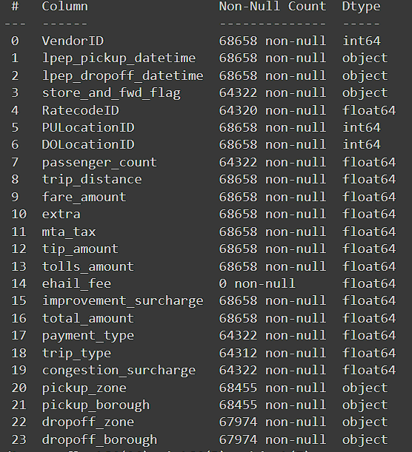
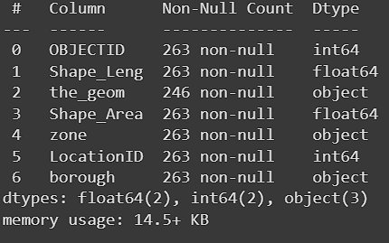
Merging 2 Datasets (NYC TLC Trip Record Dataset & Taxi Zones) in order to get the pickup and dropoff name reference.
03 | Data Preparation

Slide 14
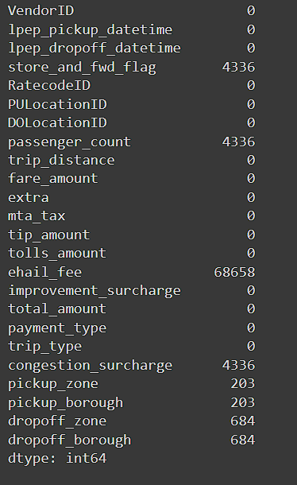
Filling and Dropping Null Value for Each Columns
03 | Data Cleaning
Null Value will be filled:
Store_and_fwd_flag, passenger_count, RatecodeID, payment_type, trip_type, congestion_surcharge.
passenger_count and congestion surcharge:
Using domain knowledge or business understanding approach.
Store_and_fwd_flag, RatecodeID, payment_type, and trip_type:
Using Descriptive Statistic approach.
Null Value will be Dropped:
Ehail_fee, pickup_zone, pickup_borough, dropoff_zone, dropoff_borough.
Ehail_fee: Column drop.
pickup_zone, pickup_borough, dropoff_zone, and dropoff_borough:
Null value drop.

Slide 15
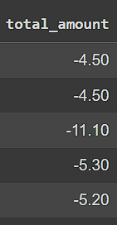
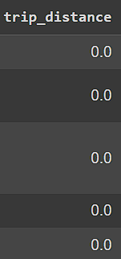
Removing Irrelevant Value for Each Column
03 | Data Cleaning
Irrelevant Value
There are several columns which contains irrelevant value based on the domain knowledge
total_amount:
Total amount is a summed up value from other variables such as fare_amount, extra, mta_tax and others that the passenger needs to pay to the driver. Thus it is irrelevant if we have total amount < 0 (negative).
trip_distance:
We dropped trip distance == 0 that recorded inside the dataset

Slide 16
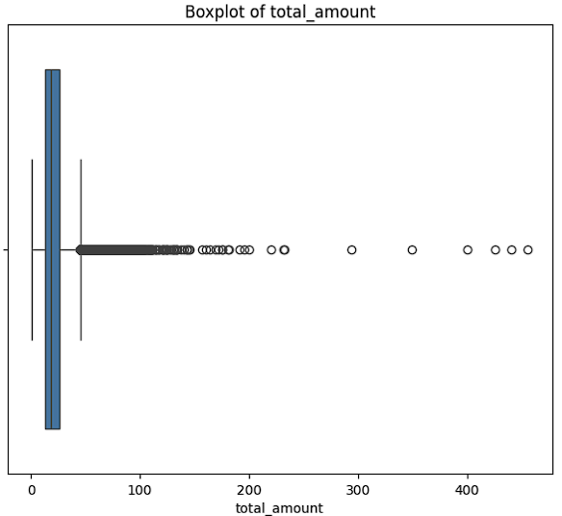
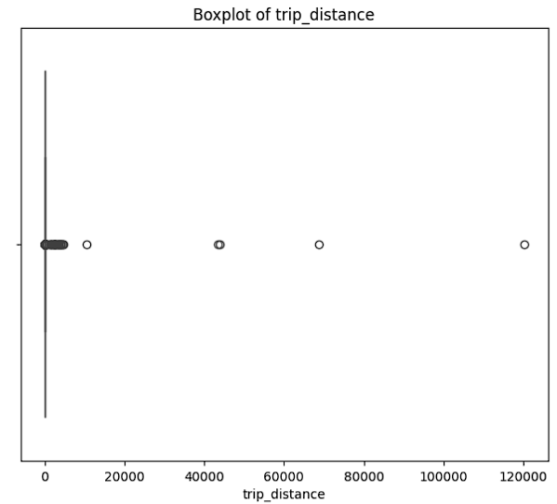
Handling Outliers (Outliers Checking and Dropping)
03 | Data Cleaning
Only focusing to drop extreme outliers for numerical columns
total _amount: dropping value more than $64.92 (calculated upper bound). 3890 (5.7%)rows data dropped.
distance_trip: dropping value more than 40 mils. Only the extreme outliers which are 37 rows data dropped.

Slide 17
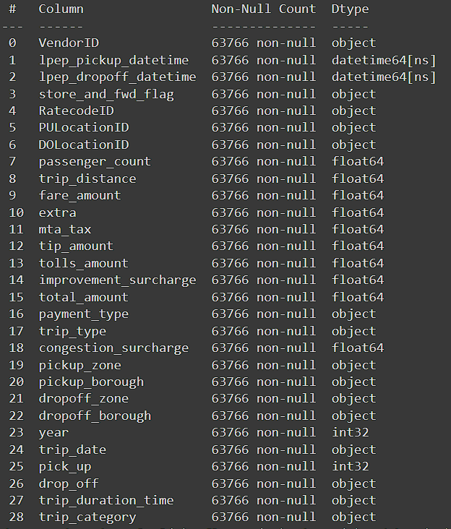
Adding Customized Variables
Cleaned Dataset: Ready to be Analyzed!
03 | Data Cleaning
Creating New Variables:
Year
Trip_date
Trip_duration_time
Trip_category
In order to perform further analysis, we try to create additional variables to help us in performing the analysis.

Slide 18
Data Analysis
04
Hypothetical Testing and EDA

Slide 19
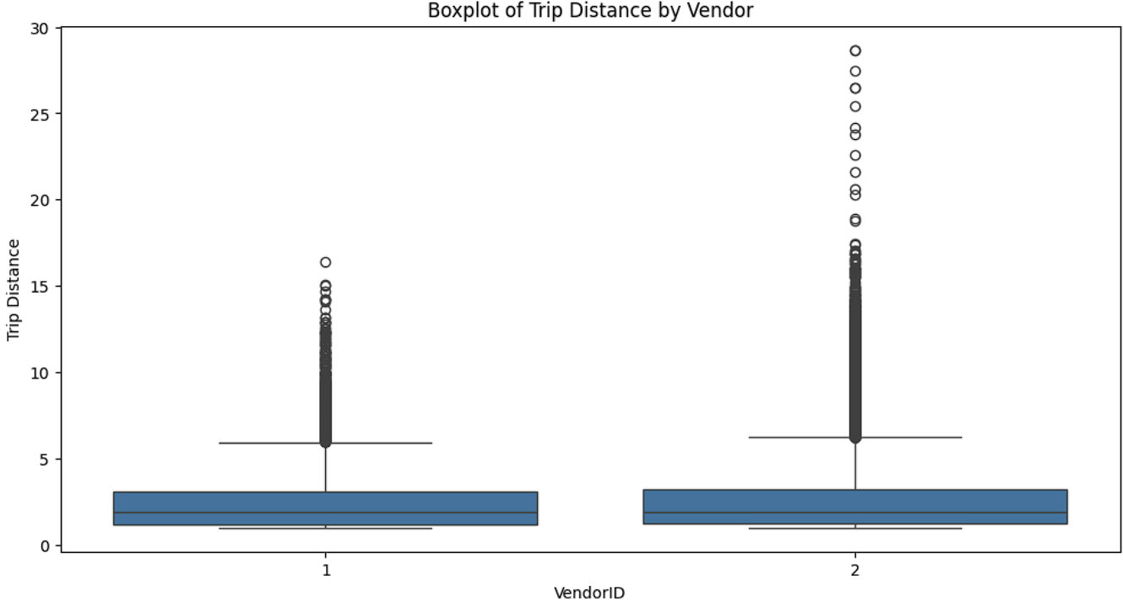
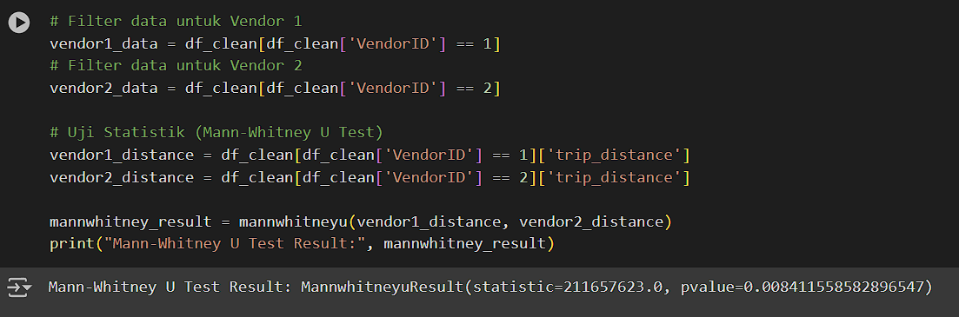
03 | Hypothetical Analysis
Trip Distance Analysis for Vehicles Tracked by Vendor 1 and Vendor 2
H0: There is no significant difference between trip distance for vehicles tracked by vendor 1 and 2
H1: There is no significant difference between trip distance for vehicles tracked by vendor 1 and 2
P-value < 0.05 suggests that there is significant difference between trip distance covered by vehicles tracked by vendor 1 and vendor 2
It means vehicles tracked by Vendor 1 did not have the opportunity to serve passengers who needed to travel longer distances.

Slide 20
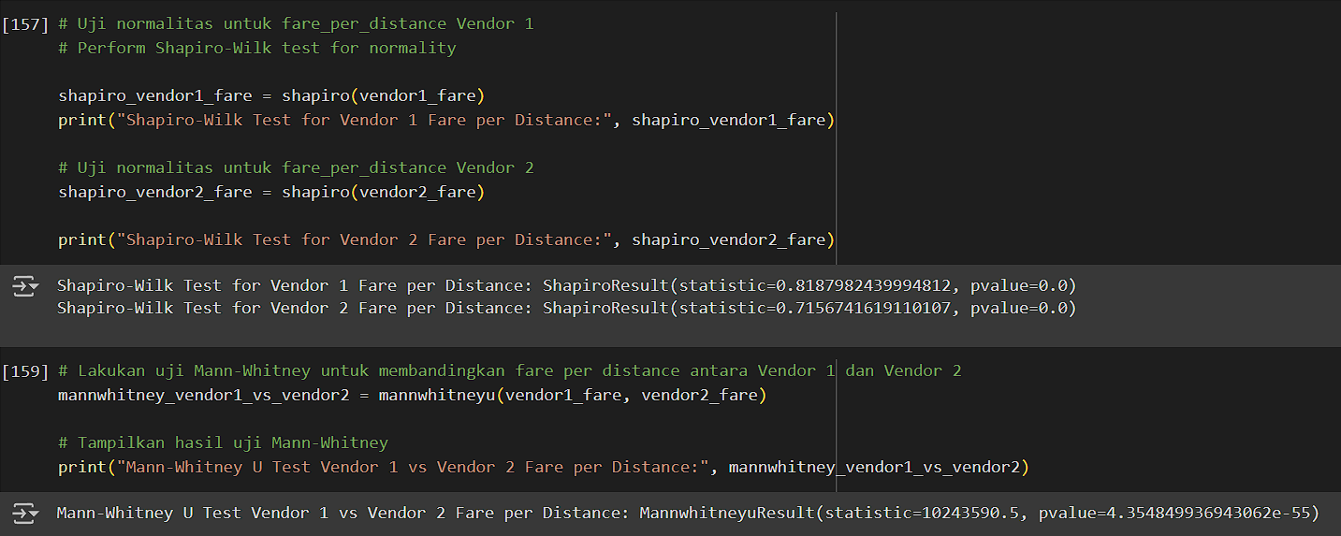
03 | Hypothetical Analysis
Average Fare Amount Per Distance Analysis Between Vehicles Tracked by Vendor 1 and Vendor 2.
H0: There is no significant difference between average fare amount per distance between trip distance for vehicles tracked by vendor 1 and 2
H1: There is significant difference between average fare amount per distance between trip distance for vehicles tracked by vendor 1 and 2
P-value < 0.05 (N: 5000, random state: 42), suggests that there is significant difference between average fare amount per distance between trip distance for vehicles tracked by vendor 1 and 2
It means vehicles tracked by vendor 1 charge less money for their fare amount per distance.
(N: 5000, random state: 42)
We use median as the measurement of the central tendency and the figure suggest that vehicles tracked by Vendor 2 charge higher fare per distance amount to the passengers.

Slide 21
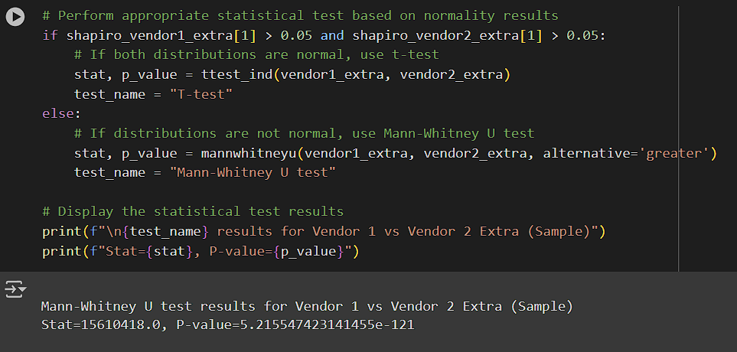

03 | Hypothetical Analysis
Extra Amount Analysis Between Vehicles Tracked by Vendor 1 and Vendor 2.
(N: 5000, random state: 42)
H0: Extra fee charged to the customer for vehicles tracked by vendor 1 is not greater than Extra fee charged to the customer for vehicles tracked by vendor 1.
H1: Extra fee charged to the customer for vehicles tracked by vendor 1 is greater than Extra fee charged to the customer for vehicles tracked by vendor 1.
P-value < 0.05 suggests that the extra fee amount charged to the customer by vehicles tracked by vendor 1 is greater than Extra fee charged to the customer for vehicles tracked by vendor 1
It means even though vehicles tracked by Vendor 1 covered shorter trip compared to vendor 2. They charge mora extra fee, due to night, rush hour, and other surcharges

Slide 22
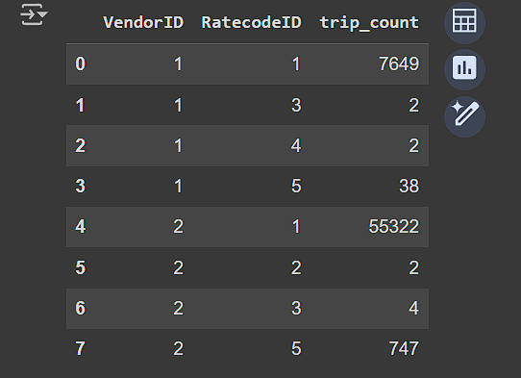
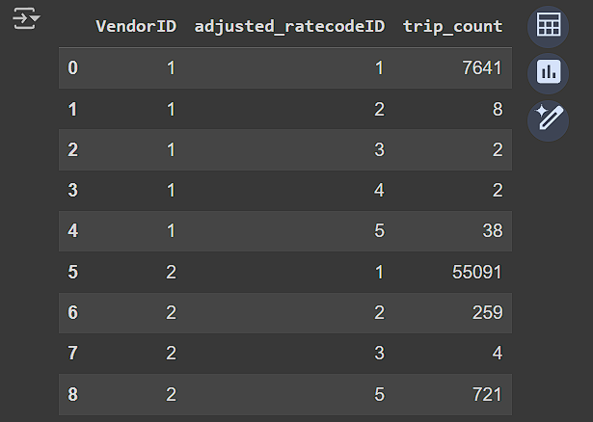
03 | Hypothetical Analysis
Trip Amount by RatecodeID Between Vehicles Tracked by Vendor 1 and Vendor 2.
Before Adjustment
After Adjustment
Some trips covered by vehicles tracked by Vendor 2 mistakenly marked trips to or from JFK Airport, leading to the fare being categorized as Rate Code 1 (standard rate) instead of Rate Code 2 (JFK rate).
This resulted in the final fare paid by passengers not aligning with the correct taxi fare to or from JFK Airport.
ratecodeID 1 : Standard Fare
ratecodeID 2 : JFK Airport
ratecodeID 3 : Newark Airport
ratecodeID 4 : Nassau or Westchester
ratecodeID 5 : Negotiated Fare
ratecodeID 6 : Group Ride

Slide 23
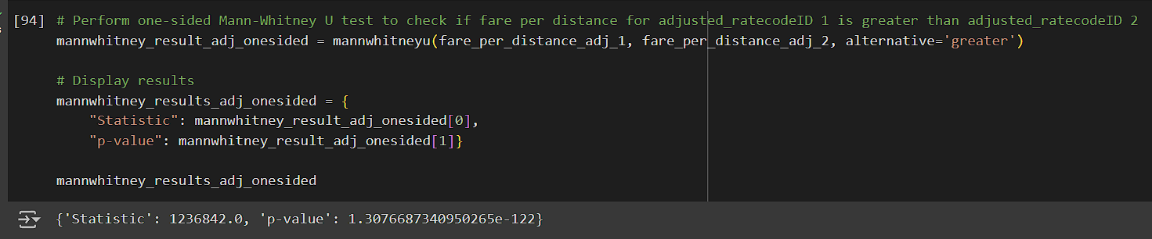

03 | Hypothetical Analysis
Trip Amount by RatecodeID Between Vehicles Tracked by Vendor 1 and Vendor 2.
(N: 5000, random state: 42)
H0: Fare amount per distance for Standard Rate is not greater than Fare amount per distance for JFK Trip
H1: Fare amount per distance for Standard Rate is greater than Fare amount per distance for JFK Trip
P-value < 0.05 suggests that Fare amount per distance for Standard Rate is greater than Fare amount per distance for JFK Trip
It means the passenger must pay more money when their trip is charged using standard rate. It also explain why the amount of trip happened for JFK trip were very low

Slide 24
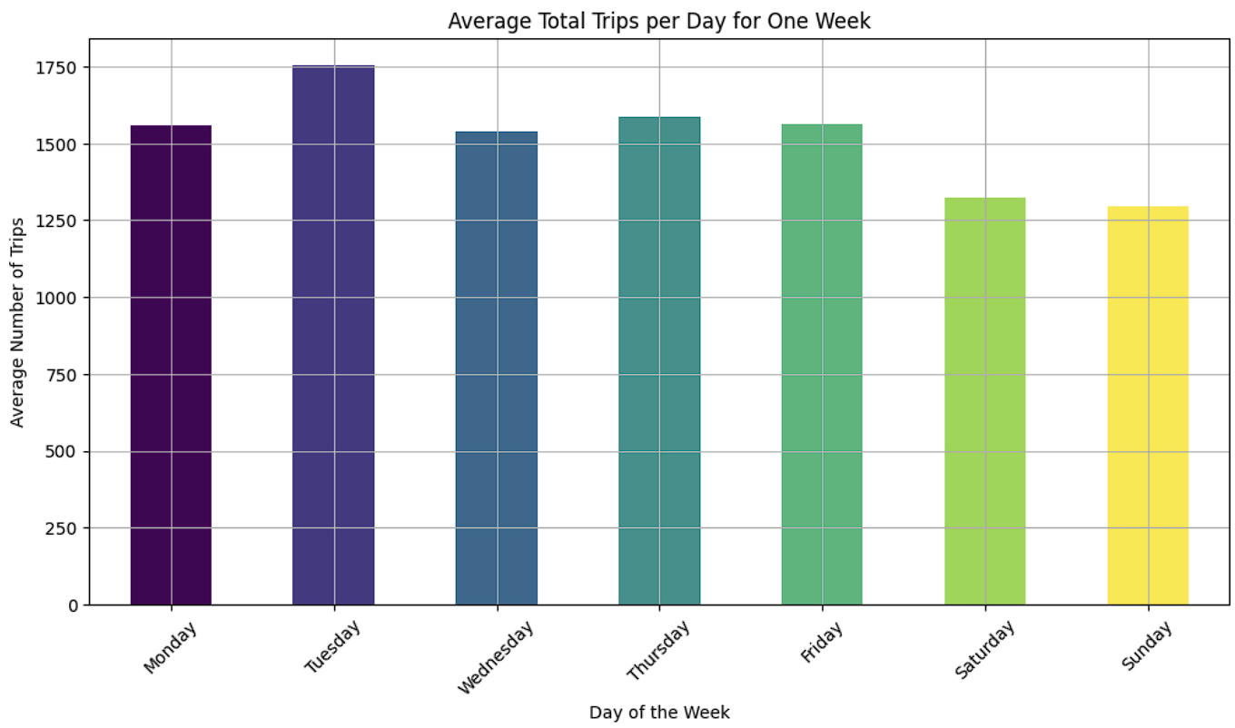
03 | Exploratory Data Analysis
Distribution Trips by Days a Week
Peak on Tuesday and Thursday: Tuesday and Thursday have the highest number of trips. These days are particularly busy for taxi services
Higher Weekday Activity: There is consistently higher activity from Monday to Thursday compared to the weekend. Weekdays are generally busier than weekends.
Weekend Decline: There is a noticeable decline in the number of trips from Friday to Sunday, with Sunday having the fewest trips. This indicates reduced taxi usage over the weekend.

Slide 25
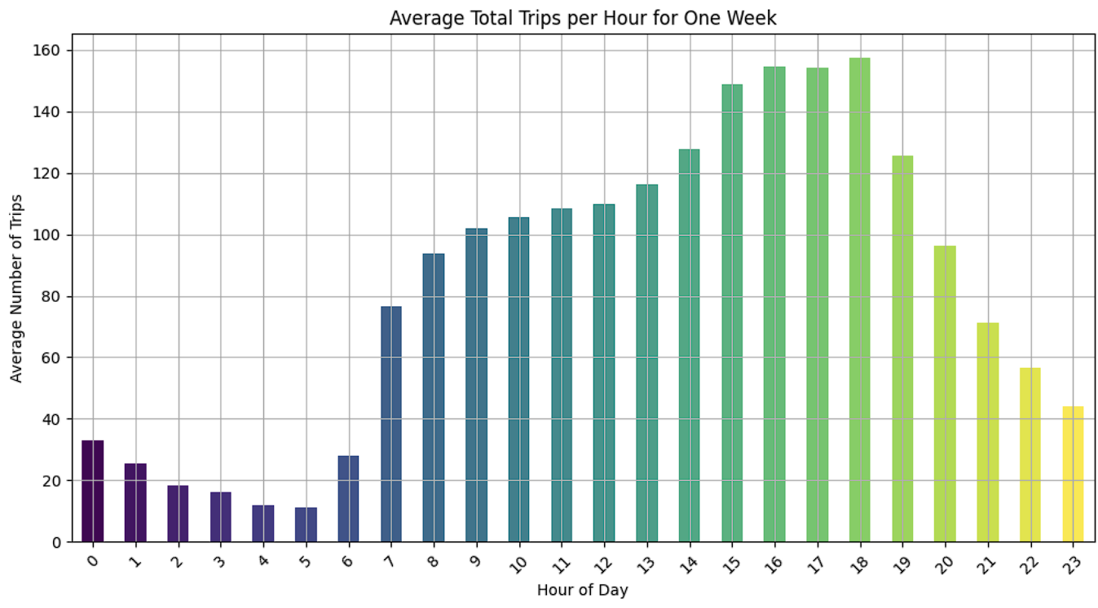
03 | Exploratory Data Analysis
Distribution Trips by Hours
Morning and Afternoon Peaks: The highest number of trips occur around 8-9 AM and 3-6 PM, indicating peak travel times likely due to commuting hours.
Midday Consistency: There is a steady number of trips from 10 AM to 3 PM, suggesting consistent taxi usage during the daytime, possibly for errands, meetings, and lunch breaks.
Late Night Low: The number of trips significantly drops from 9PM onwards, reaching the lowest point between 2-5 AM, reflecting reduced demand for taxi services late at night.

Slide 26
Recommendation
04

Slide 27
Conclusion
Conclusion
The Differences Trip Characteristics Between Vehicles Tracked by Vendor 1 and 2:
The travel distance of vehicles tracked by vendor 1 is shorter compared to vehicles tracked using Vendor 2. This suggests that these vehicles might not accept longer trips.
Based on the Rate Code ID or final pricing, vehicles tracked by vendor 1 and 2 frequently receive trips that use the Standard Rate compared to other rates. Vehicles tracked by vendor 2 received more trips for JFK Airport rate and Negotiated Fare compared to the other
Fare Amount Per Distance, or the price per mile, for Vendor 1 vehicles tends to be cheaper compared to Vendor 2. However, Vendor 1 vehicles might impose higher additional fees. This could be a reason why the number of trips with Vendor 1 is lower, as passengers tend to avoid vehicles with higher additional charges

Slide 28
Conclusion
Recommendation Based on Vehicles Trip Characteristics
1. Develop Trip Category Selection in the E-Hail App
To enhance the passenger experience and ensure accurate fare categorization, the e-hail app can be designed to allow passengers to select specific trip categories, such as trips to JFK Airport, Newark Airport, and other destinations. This will ensure that fare calculations are more precise and tailored to the trip type.
Recommendation:
Incorporate a feature in the e-hail app that allows passengers to select the type of trip they are taking, such as airport trips or standard city trips.
Example Application:
Within the app interface, provide an option for passengers to choose their trip category during the booking process. Categories can include:
JFK Airport Trip
Newark Airport Trip
Other Specific Destinations
When a passenger selects "JFK Airport Trip," the app automatically applies the JFK rate code and includes any additional fees associated with airport trips. This ensures that passengers receive the correct fare estimate upfront.

Slide 29
Conclusion
Recommendation Based on Vehicles Trip Characteristics
2. Target Short-Distance Travelers
Recommendation:
Focus marketing and promotions on short-distance travelers, such as commuters, tourists, and local residents needing quick, convenient transport within city limits.
Example Application:
Offer a "City Hopper" discount for trips under 5 or 8 miles to attract more short-distance passengers.
Partner with local businesses and attractions to provide discount codes for tourists and visitors needing short rides within the city.
3. Adjust Additional Fees
Recommendation:
Reevaluate and possibly reduce additional fees (extra) to make Vendor 1 vehicles more attractive to cost-conscious passengers.
Example Application:
Introduce a loyalty program where frequent riders can accumulate points that reduce additional fees.
Run promotional campaigns where additional fees are waived or reduced for first-time users or during specific off-peak hours.

Slide 30
Conclusion
Conclusion
Passengers Trips Preferences or Characteristics on Operating Time and Days:
Peak Hours: The highest number of trips occurs between 3:00 PM and 7:00 PM, with the peak around 6:00 PM. This indicates that late afternoon to early evening is the period with the highest taxi activity, likely due to many people commuting home or engaging in activities after work hours.
Off-Peak Hours: The lowest number of trips occurs between 2:00 AM and 5:00 AM. Taxi activity significantly decreases in the early morning hours, likely due to low demand during this time.
Days with the Highest Number of Trips: Tuesday has the highest number of trips. Wednesday also shows a high number of trips, closely approaching the count on Tuesday.
Days with the Lowest Number of Trips: Saturday and Sunday have the lowest number of trips, each below 9,000 trips. This indicates that the weekend has lower taxi activity compared to weekdays.
Relatively Stable Weekday Distribution: Monday, Thursday, and Friday show a relatively stable number of trips, each ranging from about 9,000 to 10,000 trips. This reflects that taxi demand remains high and stable during the weekdays.

Slide 31
Conclusion
Recommendation
4. Increase Fleet Availability on High-Demand Days
Insight: Tuesday and Thursday have the highest number of trips.
Recommendation: Ensure maximum fleet availability on these days by scheduling more drivers and vehicles. Example Application:
Strategy: Implement a flexible scheduling system.
Action: Offer incentives such as bonuses for drivers who work on high-demand days. For example, provide a $20 bonus for each shift completed on Tuesdays and Thursdays.
5. Introduce Dynamic Pricing
Insight: The number of trips varies significantly throughout the week.
Recommendation: Implement dynamic pricing to manage demand and maximize revenue. Example Application:
Strategy: Adjust fares based on demand.
Action: Increase fares by 10% on Tuesdays and Thursdays and offer a 15% discount on weekends to encourage more trips. Use the e-hail app to notify passengers about these dynamic pricing changes.

Slide 32
End of Analysis

Slide 33
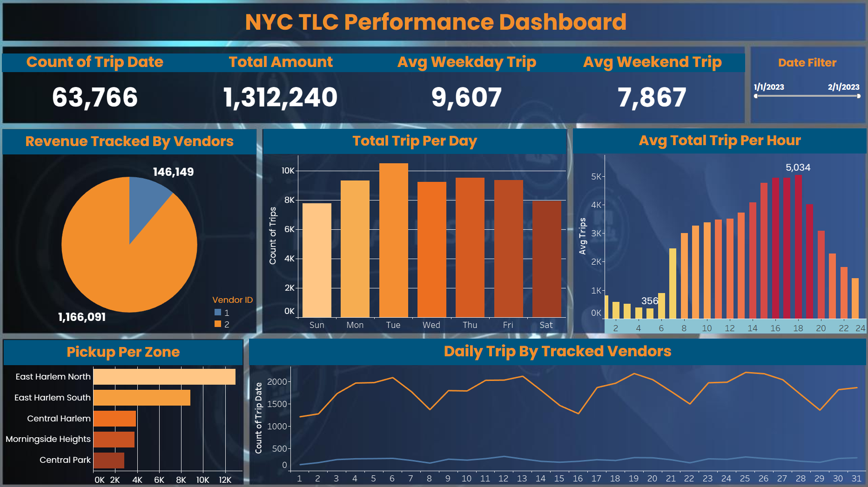
Screenshot of Dashboard

Slide 34


Appendix
Link to Dashboard
Link to Python

